Slide 1

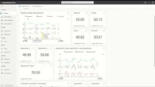
BUILD AGILE PLANNING AND DISTRIBUTION PROCESSES
Ensure business continuity
Track IoT Devices in IoT Central
Simplifies IoT solution creation.
Provides real-time visibility and control over IoT devices.
Enables data-driven decision making through advanced analytics.
Offers scalable and secure cloud infrastructure.
Reduces time to market for IoT solutions.
Azure IOT Central

